Slide 1
Yoga is the journey of the self, through the self, to the self the bhagavad gita

Slide 2
What is yoga AND MEDITATION?
YOGA: A spiritual discipline based on extremely subtle science which focuses on bringing harmony between mind and body. It is an art and science of healthy living.
It is the union of individual self and universal consciousness.
MEDITATION: A type of mind-body complementary medicine that produces a deep state of relaxation and a tranquil mind.
Mental exercise involving relaxation, focus and awareness.

Slide 3
History and origin
Originated in Northern India over 5000 years ago
Yoga come from sanskrit word “yuj” which to join.
Father of Yoga: Maharishi Patanjali
International Yoga day: 21 June

Slide 4
IMPORTANCE OF YOGA
Attainment of perfect equilibrium and harmony.
Increases self-awareness and enhances personal power.
Removes negative blocks from mind.
Helps in attention, focus and concentration.
Reduces stress and tension in physical body by activating the nervous system.

Slide 5
Benefits of yoga
Increases Confidence (very important thing for managers and leaders)
Improves Focus and flexibility
Helps us to relate with people
Becoming a good leader
Keeps you fit .

Slide 6
Benefits of MEDITATION
Improves concentration and memory
Relax against stress
Strengthens the immune System.
Lowers distraction
Easy to grasp things
Helps to be more creative
Helps to be more tolerant and sensitive
Helps to control your anger
Energizes

Slide 7
Some reserch info:
There are 300 million yoga practitioners in world.(thegoodbody.com)
According to yoga Benefit Statistics, half of US population uses yoga and meditation to reduce stress.
A 2017 meta analysis of 23 inventions concluded that yoga can now be considered as an effective alternative treatment for Major depressive disorder(MDD). (healthline.com)

Slide 8
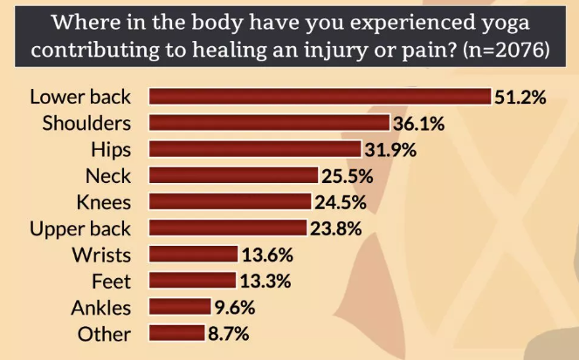
Statistics showing use of yoga to heal injury:

Slide 9
CONCLUSION
Yoga have great benefits for both our physical as well as mental health and for every person no matter what job he/she do or the age group of the person.
It increases the productivity of work and helps to build various qualities.
We should do yoga and meditation in order to be physically fit and mentally fresh.

Slide 10
Contact info
For online yoga sessions:
Join us at gethealthyWithYoga.com
For more info:
Call or text @ 777-888-9999
Email id – gethealthy123@gmail.com

